Slide 1
Social Media for Nonprofits
How and Why of Social Media for Nonprofits

Slide 2
Agenda
Finding Your Place | Where you should be sharing on Social Media
Introduction to top social media platforms
Different platforms attract different audiences
Highlighting which channels may be more tuned to the specifics of each organization
Starting The Fire and Keeping It Going | Creating Shareable Content
#Hashtags, @mentions, direct messages and linking
Using STEPPS to create maximize sharing

Slide 3
Finding Your Place
Where You Should Be on Social Media

Slide 4
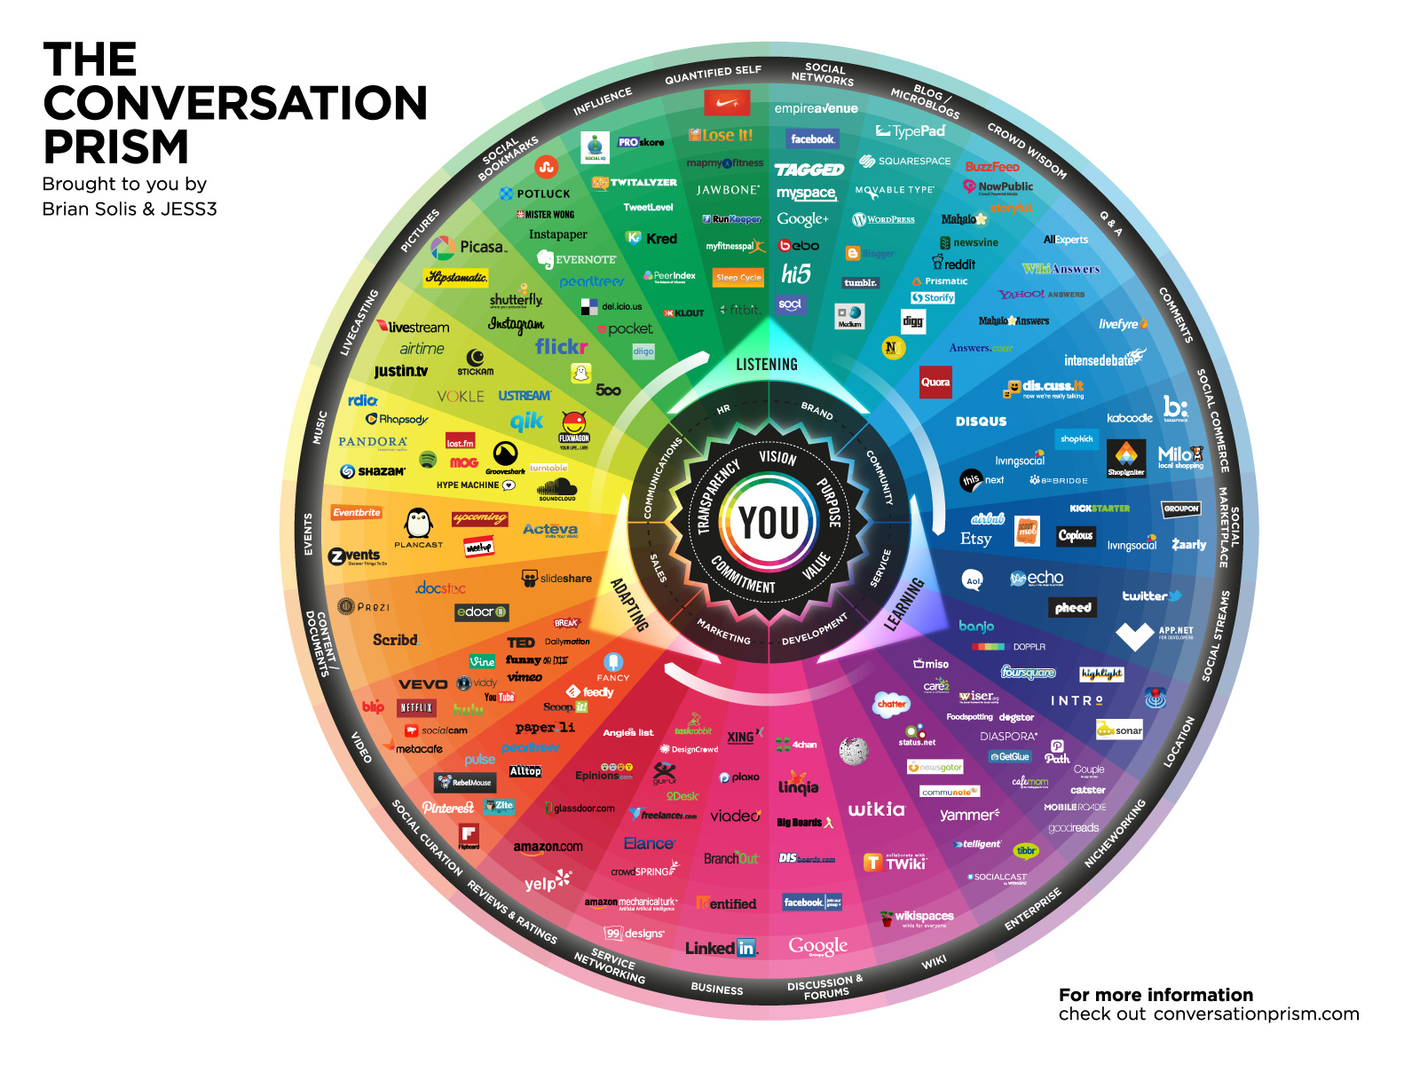

Slide 5
Social Networks
Pictures
Social Streams
Video
Social Curation
Business

Slide 6
Social Networks
Social Streams
Business

Slide 7
The Big Three
Who uses:
71% of online adults
Over 1.15 billion active users
All genders, races, and age groups use at a high rate
Slightly higher rate of women
Rate of usage decreases with age
Who uses:
Over 550 million registered users
Over 215 million active monthly users
Used by 18% of online adults
Higher adoption rate in younger generations
Who uses:
300 million users
Used by 22% of online adults
Most affluent membership
Higher adoption rate in older generations

Slide 8
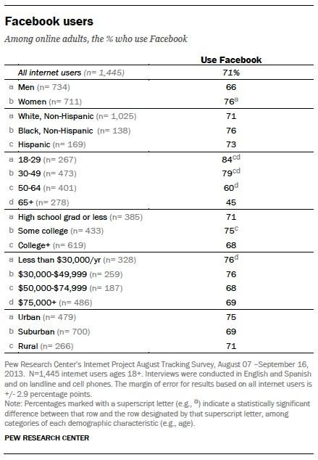
Facebook
Demographics

Slide 9
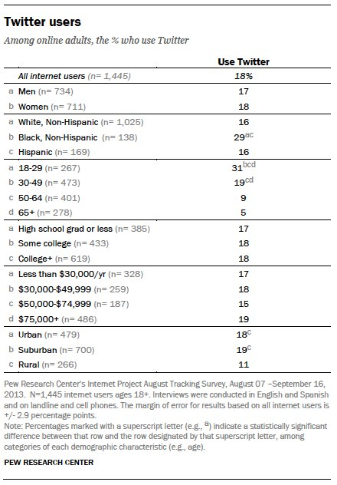
Twitter
Demographics

Slide 10
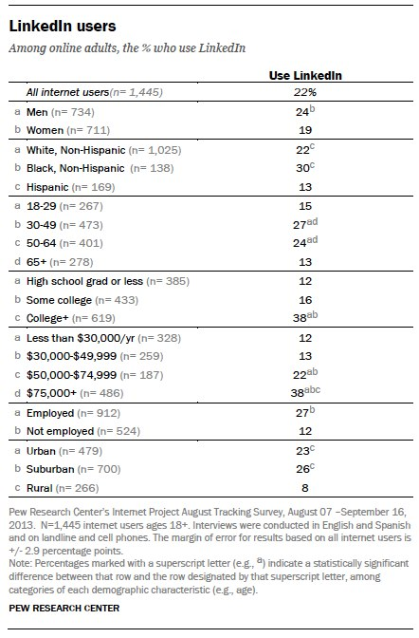
LinkedIn
Demographics

Slide 11
The Big Three
Who uses:
71% of online adults
Over 1.15 billion active users
All genders, races, and age groups use at a high rate
Slightly higher rate of women
Rate of usage decreases with age
Who uses:
Over 550 million registered users
Over 215 million active monthly users
Used by 18% of online adults
Higher adoption rate in younger generations
Who uses:
300 million users
Used by 22% of online adults
Most affluent membership
Higher adoption rate in older generations

Slide 12
How are they used?
Discussion Medium
Facebook members tend to add comments to articles and pictures more often
Entertainment
Playing games
Connecting with old acquaintances
News
Recently, a source for news
News
Live, late breaking news
Specialized news
Access
Behind the scenes
Celebrities
Nuggets
Feedback
Direct connections with brands
Employment
Businesses looking for new talent
Employees looking for jobs
Professional Events/Groups
Individuals looking to increase their professional value
Networking within certain industries or localities

Slide 13
Craft your message to fit the platform
Ask questions to evoke a response.
Use longer format to tell a story.
Provide “insider information”
Use #hashtags to promote events, topics
Use connections to grow list of professionals
Post relevant information for professional development

Slide 14
Social Networks
Pictures
Social Streams
Video
Social Curation
Business

Slide 15
Social Networks
Pictures
Video
Social Curation

Slide 16
You should consider…
Over 1 billion active accounts
359 million active monthly users
Tied to Google services
Ties into google search results
Second largest search engine
Over 1 billion active monthly users
Largest music streaming service
Tied to Google services
Ties into Google search results
Larger user base than Twitter
Growing quickly
Visual medium
Core user base is between 18-49, educated, affluent women
Owned by Facebook
Image based
Heavily used by younger user base
Mobile First Platform

Slide 17
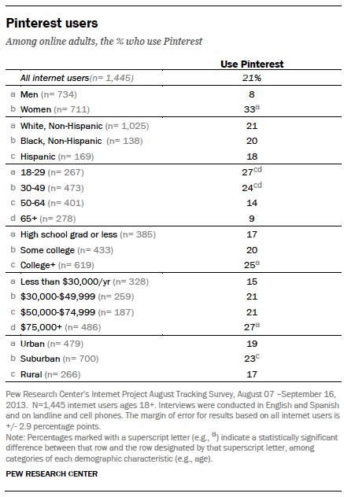
Pinterest
Demographics

Slide 18
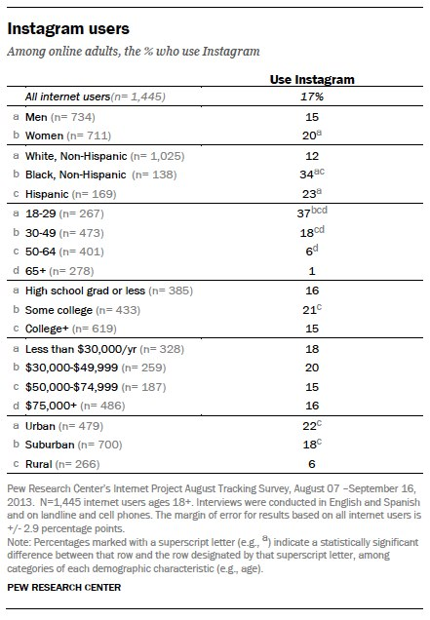
Instagram
Demographics

Slide 19
Starting the Fire and Keeping It Going
Creating Shareable Content

Slide 20
#hashtags, @mentions, direct messages and linking

Slide 21
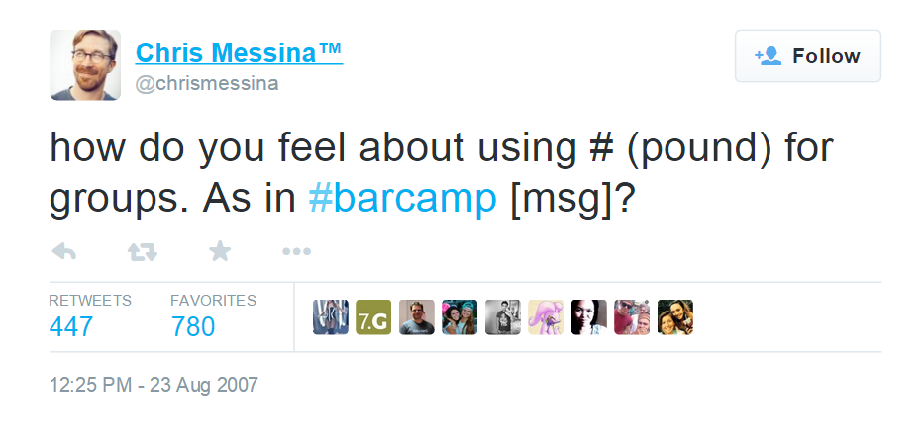
#hashtags
Started in 2007 as a way to group things on twitter, now supported by most social media platforms.
Hashtags tie things together and allow users to join a larger conversation.
Great for live events and conferences
Should be short and to the point
Tips:
Search first
Use different case to differentiate words
Be ready for possible negative attention, have a plan
Usage is different by channel:
Facebook -> fewer hashtags, more interaction
Twitter -> use one or two hashtags
Instagram -> use as many hashtags as you can think of
#IceBucketChallenge, #SFBatKid, #SOTU

Slide 22
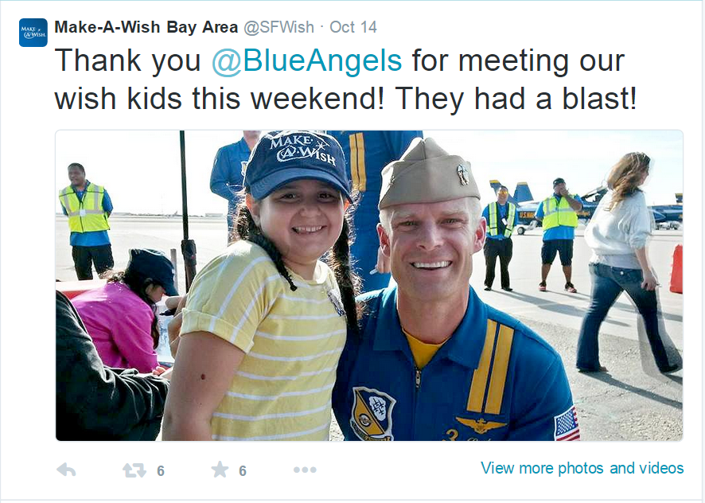
@mentions
Used in most platforms (@ sign is for twitter)
Links to other users
Useful in starting or continuing conversations with a brand or a user
Great way to work with celebrity endorsements
Very useful when saying thank you or congratulating
Great when partnering with another organization
Can help expand your network of influence
Example of @mentions working well: #IceBucketChallenge

Slide 23
direct messages
Private messages to individual users
Level of access that is hard to find
This differs by platform, but the big three have ways to send a direct message.
Some brands, celebrities, accounts are run by a marketing team, but many are run by the people themselves, or someone who is very close to them.

Slide 24
linking
One of the most important thing to consider when posting on Social Media
Social Media is like the kindling of a fire, it can get things heated up, but you need real content behind it to sustain.
Use url shorteners like bit.ly or goo.gl to both shorten the url and track the results
Use your social media to drive traffic to your blog or your event site
This is your opportunity to get their attention, and then keep their attention…don’t waste it.

Slide 25
Creating Shareable Content

Slide 26
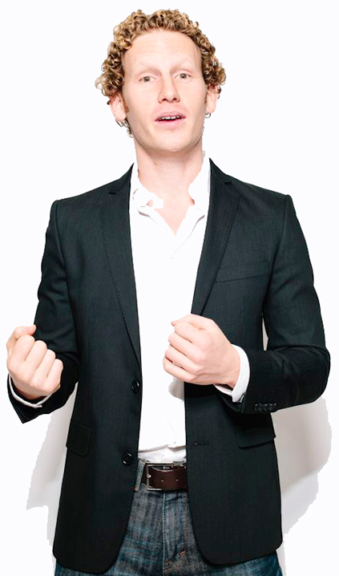
STEPPS Method
STEPPS Method is based off of the book “Contagious: Why Things Catch On” by Jonah Berger.

Slide 27
The 6 Keys to STEPPS
Social Currency – Make people look good to others
Triggers – Things that keep your brand “top-of-mind”
Emotion – “When people care, they share”
Public – “Monkey see, monkey do”
Practical Value – People like helping other, will share useful tips
Stories – Always more memorable than facts or “spec selling”

Slide 28
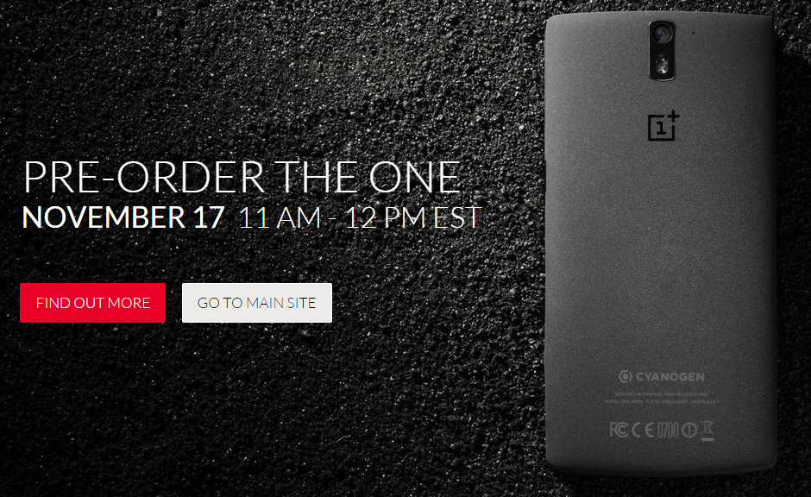
Social Currency
How to make someone look good?
Do they have inside information about something?
Do they have something that is rare or unique?
Are they “in the know”?
Example: OnePlus One Phone
Make People Look Good

Slide 29
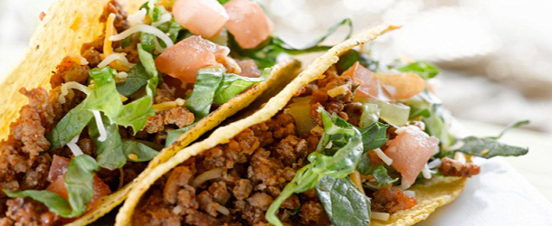
Triggers
Look for events that happen regularly
Days of the week
Try to get things to go together – Peanut butter and …
Be sure that trigger happens when it is time for a decision
“Taco Tuesday”
Top-of-mind

Slide 30
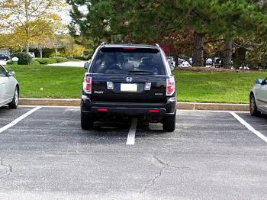
Emotion
When people care about a subject, they will be more willing to share with their friends and families.
Emotion arousal level is important.
Content and sad, are low arousal emotions
Excited and angry, are high arousal emotions
“When We Care, We Share”

Slide 31
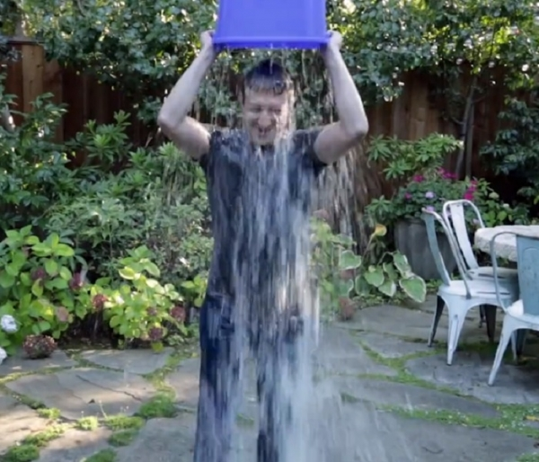
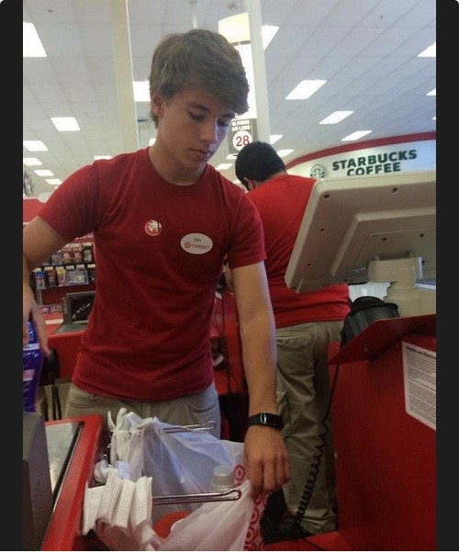
Public
People often imitate the actions of others.
Share the actions you wish to have repeated by others.
People can also drive traffic by trying to find out what is going on.
Example:
Connection with celebrities
“Monkey See, Monkey Do”

Slide 32
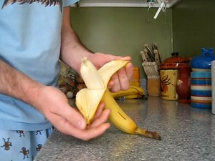
Practical Value
People want to help out their friends and family, help them.
Examples: How to peel a banana (9.5 million views)
“News You Can Use”

Slide 33
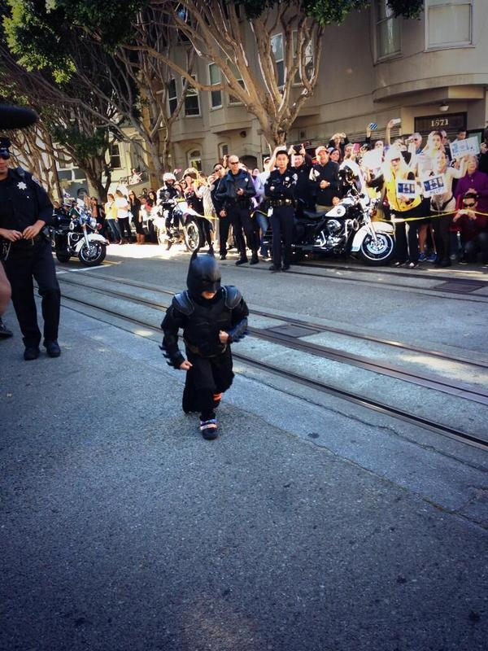
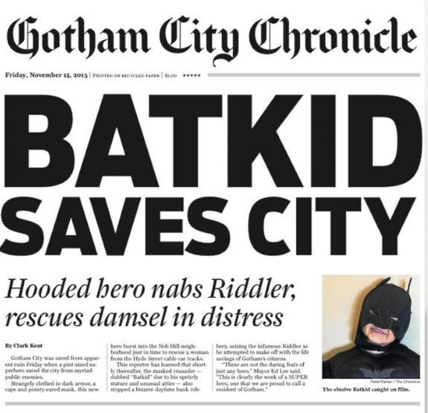
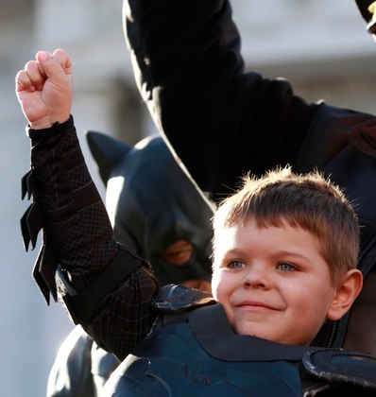
Stories
We remember stories, we don’t remember facts.
Make sure your brand is an important detail in the story.
Examples:
#SFBatKid
Facts Get Lost, Stories Live On

Slide 34
Putting it Together
Using one or two of the STEPPS keys well is better than forcing all of them poorly.
Be sure to include appropriate hashtags, mentions, and linking.
Plan ahead and work with purpose.

Slide 35
Exercises

Slide 36
#alexfromtarget
Social Currency
Triggers
Emotion
Public
Practical Value
Stories
Why does this work/not work?

Slide 37
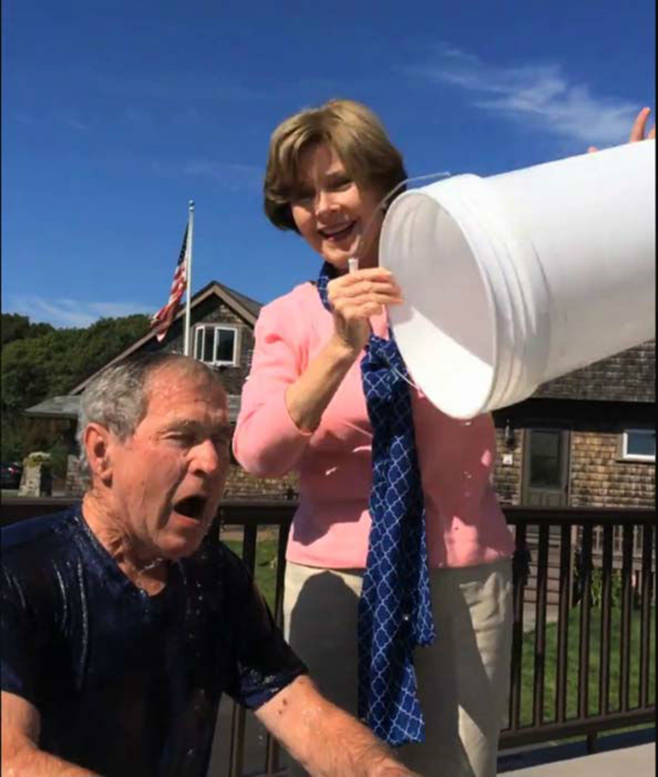
#IceBucketChallenge
Social Currency
Triggers
Emotion
Public
Practical Value
Stories
Why does this work/not work?

Slide 38
#SFBatKid
Social Currency
Triggers
Emotion
Public
Practical Value
Stories
Why does this work/not work?

Slide 39
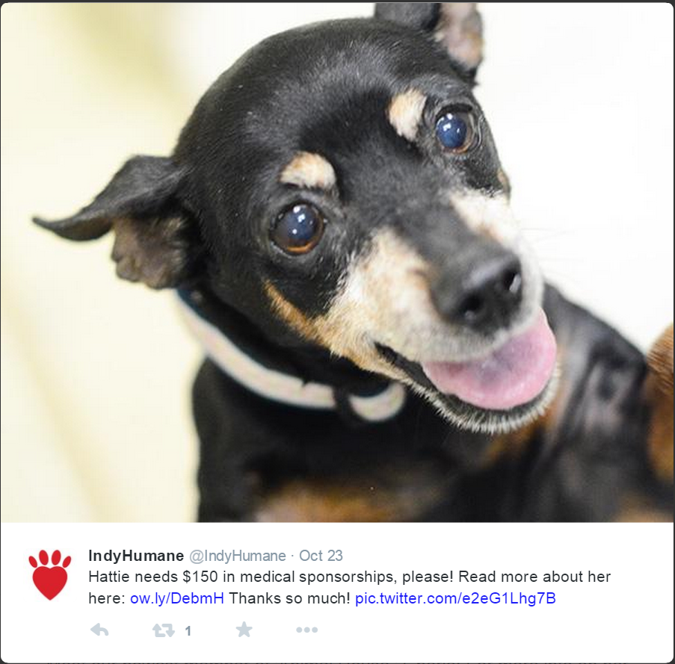
Social Currency
Triggers
Emotion
Public
Practical Value
Stories
Why does this work/not work?

Slide 40
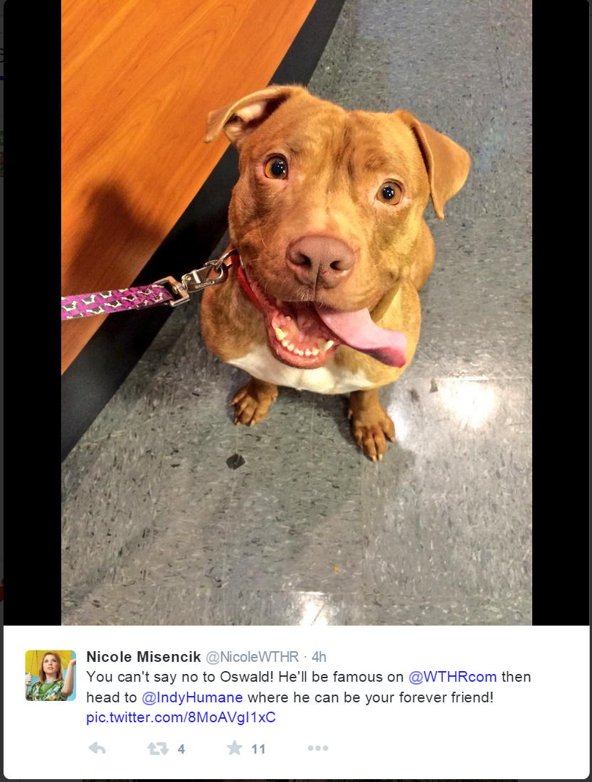
Social Currency
Triggers
Emotion
Public
Practical Value
Stories
Why does this work/not work?

Slide 41
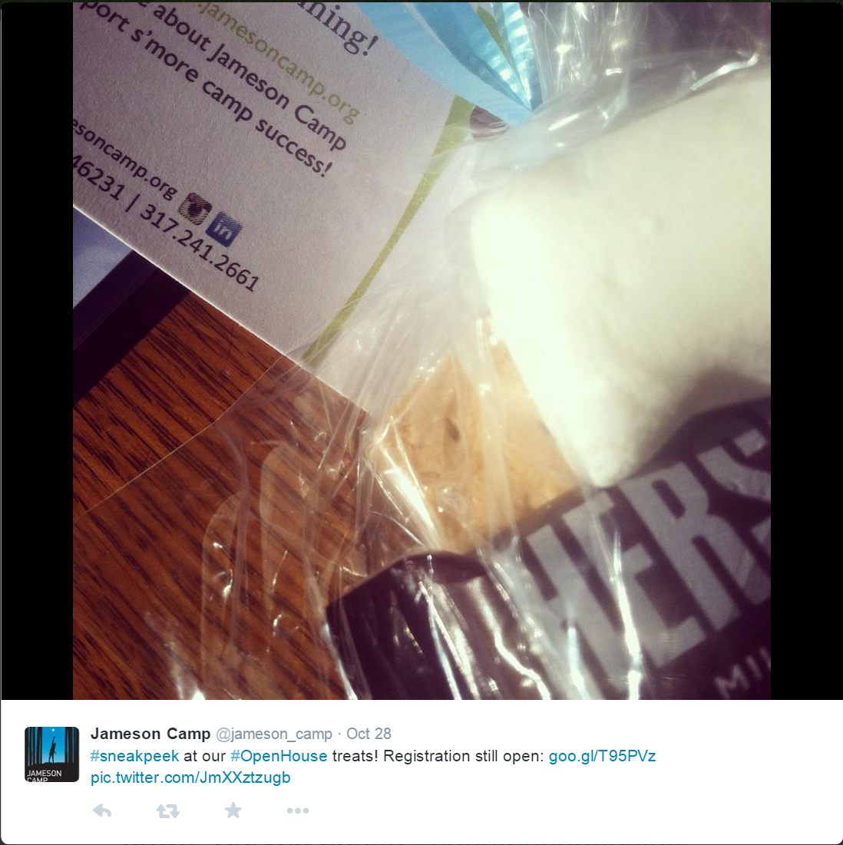
Social Currency
Triggers
Emotion
Public
Practical Value
Stories
Why does this work/not work?

Slide 42
Social Currency
Triggers
Emotion
Public
Practical Value
Stories
Why does this work/not work?

